Slide 1
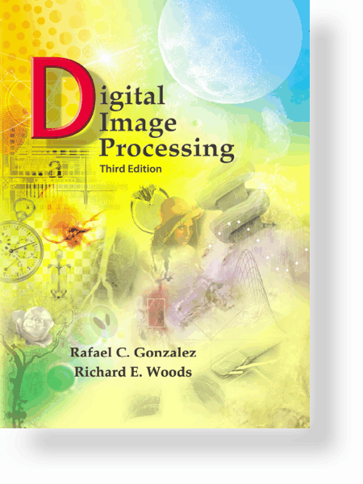
UNIT – II: Image Enhancement in the Frequency Domain
Syllabus
Basics of filtering in frequency domain
Image smoothing using frequency domain filters
Ideal Low pass Filter
Butterworth Low pass Filter
Gaussian Low pass Filter
Image sharpening using frequency domain filters
Ideal High pass Filter
Butterworth High pass Filter
Gaussian High pass Filter
Laplacian in the frequency domain
Homomorphic filtering

Slide 2
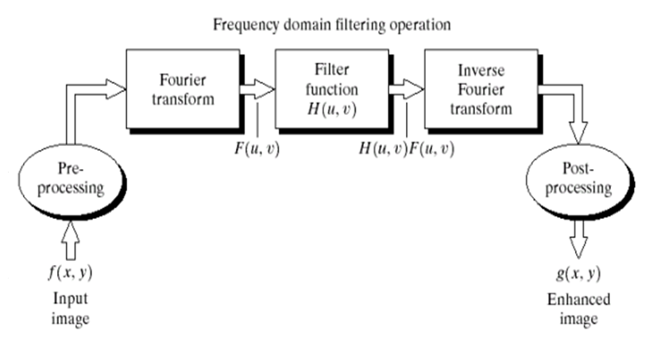
UNIT – II: Image Enhancement in the Frequency Domain
Basics of filtering in frequency domain
Basic steps for filtering in the frequency domain

Slide 3
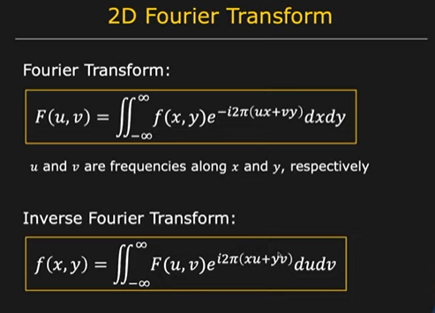

Slide 4
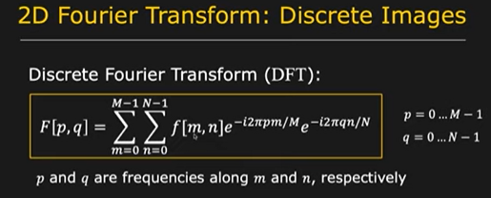
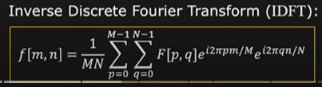
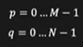

Slide 5
UNIT – II: Image Enhancement in the Frequency Domain
Smoothing Frequency-Domain Filters
Ideal Low pass Filter
Butterworth Low pass Filter
Gaussian Low pass Filter

Slide 6
UNIT – II: Image Enhancement in the Frequency Domain
Ideal LPF

Slide 7
UNIT – II: Image Enhancement in the Frequency Domain
Contd…

Slide 8
ILPF Filtering Example
D0 = 10,30,60,160,460 respectively

Slide 9
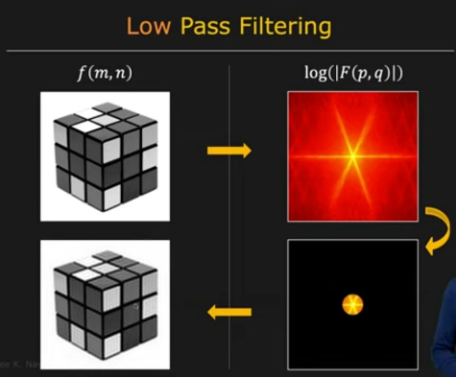

Slide 10
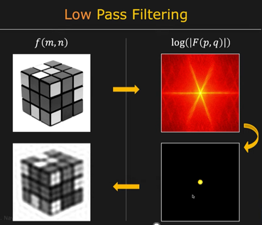

Slide 11
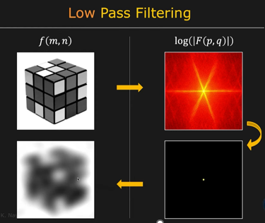

Slide 12
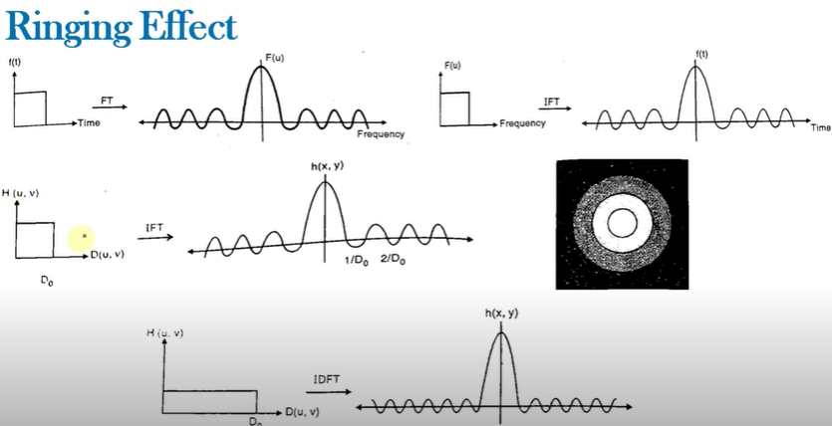

Slide 13
UNIT – II: Image Enhancement in the Frequency Domain
Butterworth LPF

Slide 14
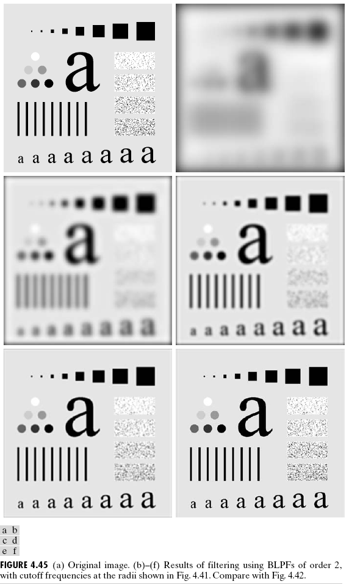

Slide 15
UNIT – II: Image Enhancement in the Frequency Domain
Gaussian LPF

Slide 16
UNIT – II: Image Enhancement in the Frequency Domain
Contd…

Slide 18
UNIT – II: Image Enhancement in the Frequency Domain
Example: Gaussian LPF

Slide 19
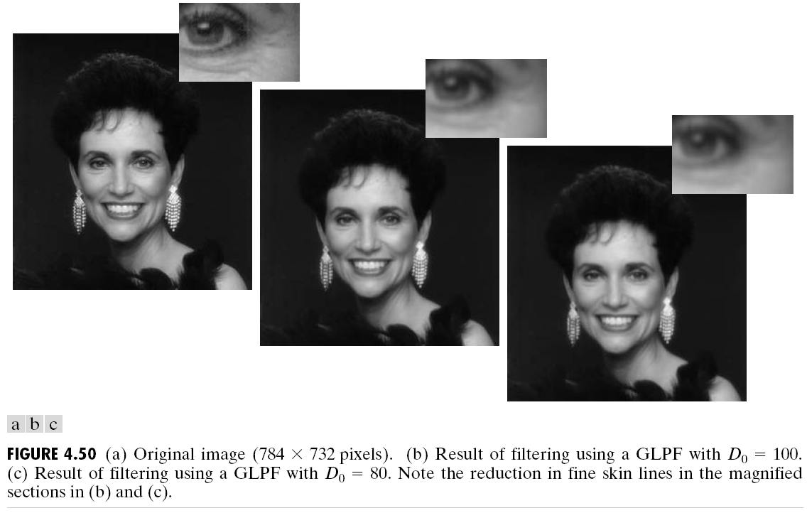
UNIT – II: Image Enhancement in the Frequency Domain
Example: Gaussian LPF

Slide 20
UNIT – II: Image Enhancement in the Frequency Domain
Example: Gaussian LPF

Slide 21
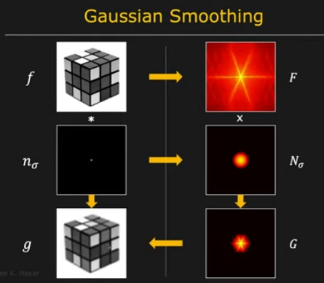

Slide 22
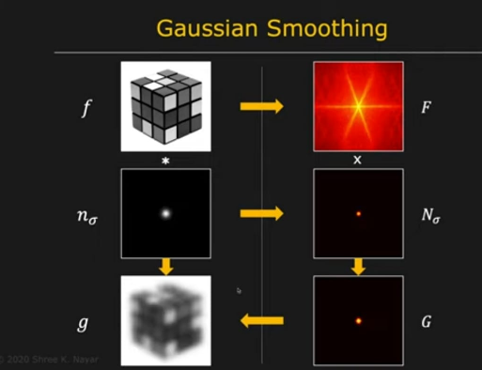

Slide 23
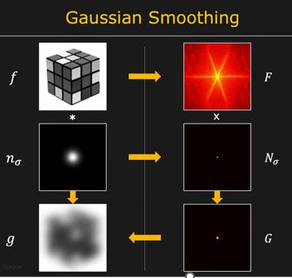

Slide 24
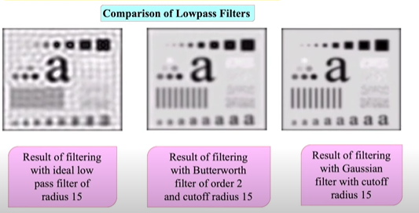

Slide 25
UNIT – II: Image Enhancement in the Frequency Domain
Sharpening Frequency-Domain Filters
Ideal High pass Filter
Butterworth High pass Filter
Gaussian High pass Filter
Laplacian in the Frequency domain

Slide 26
UNIT – II: Image Enhancement in the Frequency Domain
Ideal HPF
A highpass filter is obtained from a given lowpass filter using

Slide 27
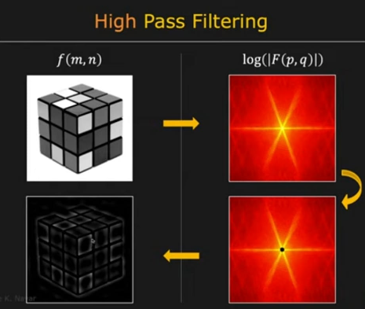

Slide 28
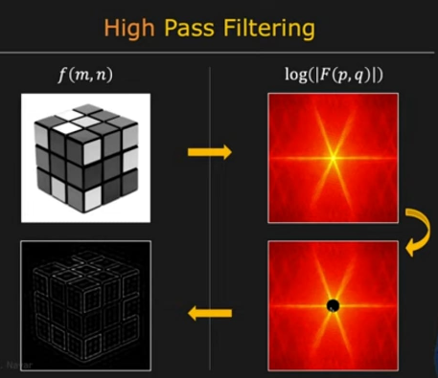

Slide 29
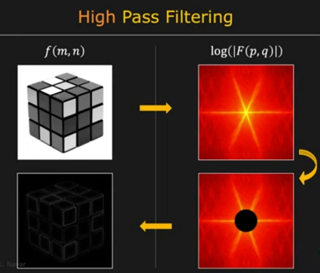

Slide 30
UNIT – II: Image Enhancement in the Frequency Domain
Butterworth & Gaussian HPF

Slide 31
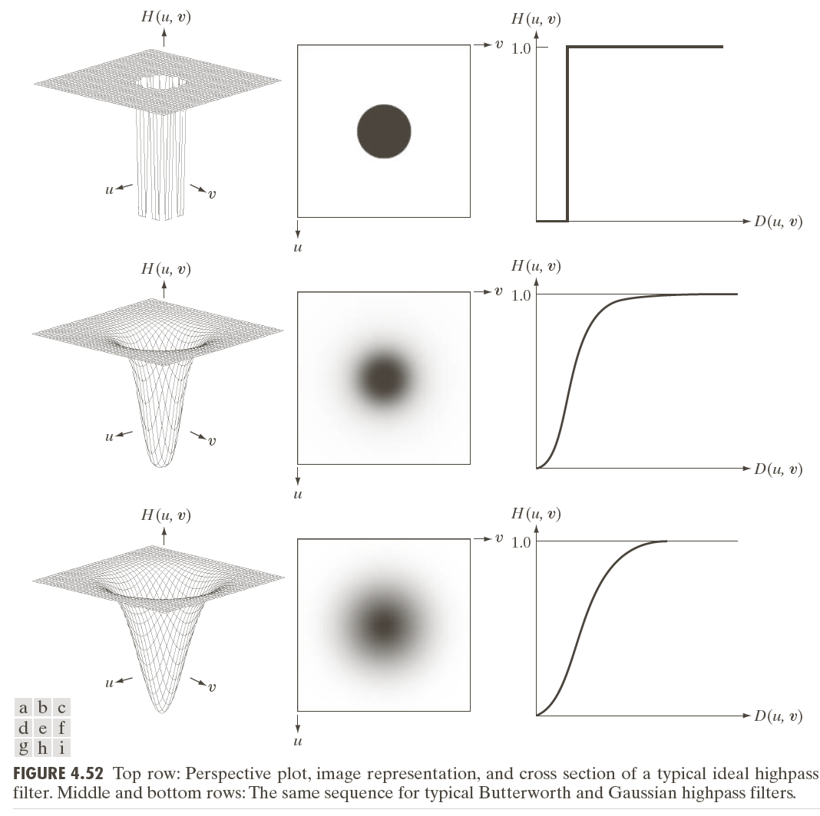


Slide 32
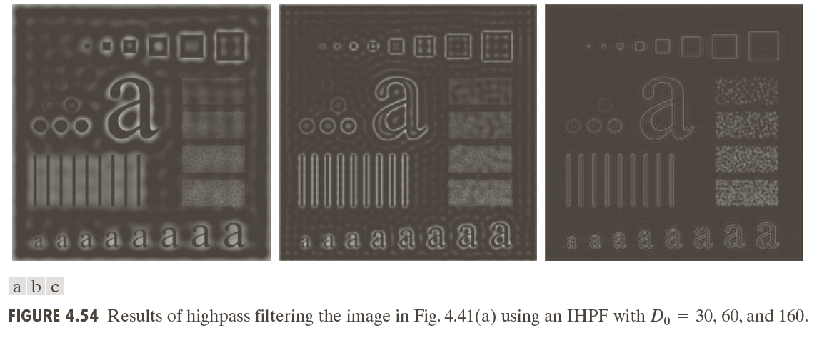
UNIT – II: Image Enhancement in the Frequency Domain
Example: Ideal HPF

Slide 33
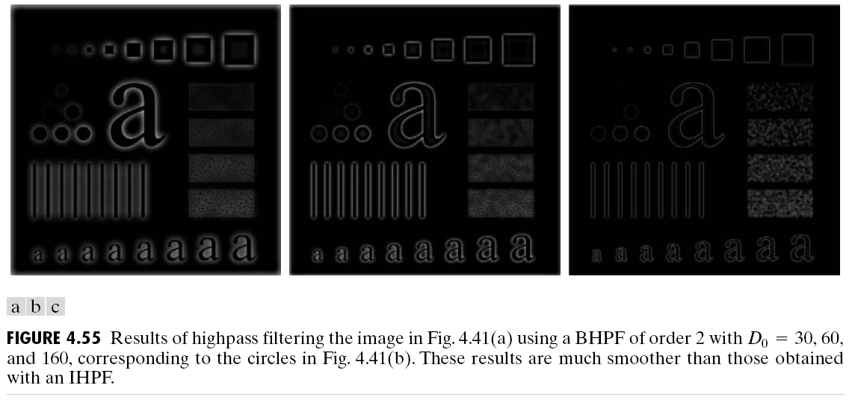
UNIT – II: Image Enhancement in the Frequency Domain
Example: Butterworth HPF

Slide 34
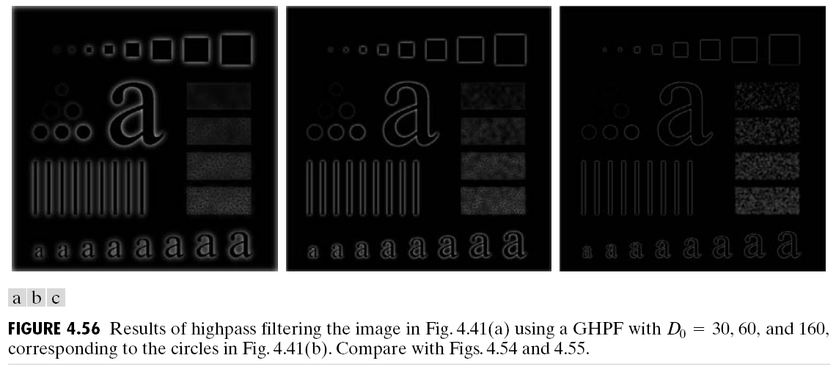
UNIT – II: Image Enhancement in the Frequency Domain
Example: Gaussian HPF

Slide 35
UNIT – II: Image Enhancement in the Frequency Domain
The Laplacian in the Frequency Domain

Slide 36
UNIT – II: Image Enhancement in the Frequency Domain
Contd…

Slide 37
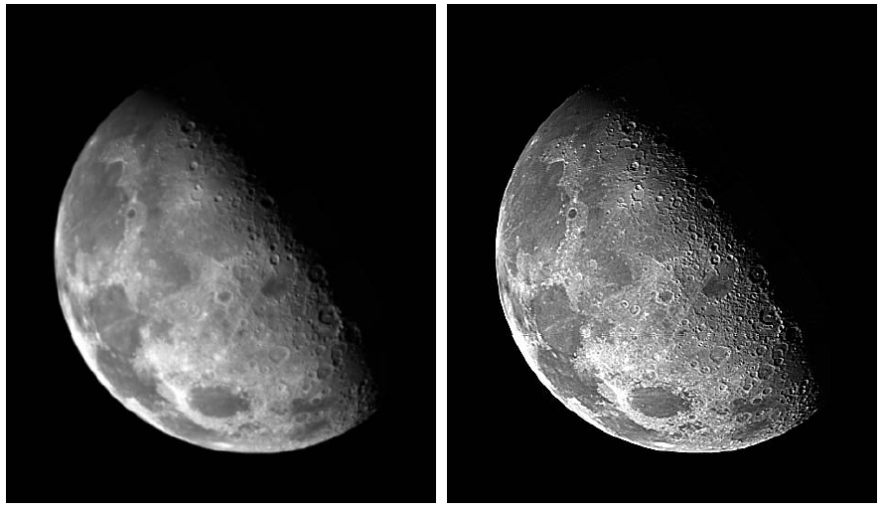
UNIT – II: Image Enhancement in the Frequency Domain
Example: Laplacian

Slide 38
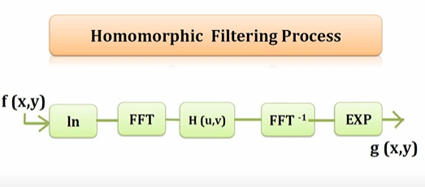
UNIT – II: Image Enhancement in the Frequency Domain
Homomorphic Filtering

Slide 39
UNIT – II: Image Enhancement in the Frequency Domain
Homomorphic Filtering
=
?

Slide 40
UNIT – II: Image Enhancement in the Frequency Domain
Contd…

Slide 41
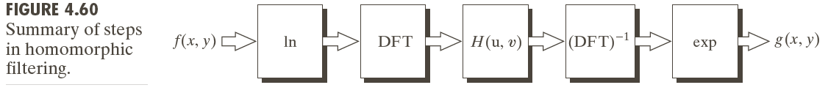
UNIT – II: Image Enhancement in the Frequency Domain
Contd…
The illumination component of an image generally is characterized by slow spatial variations, while the reflectance component tends to vary abruptly
These characteristics lead to associating the low frequencies of the Fourier transform of the logarithm of an image with illumination the high frequencies with reflectance.

Slide 42
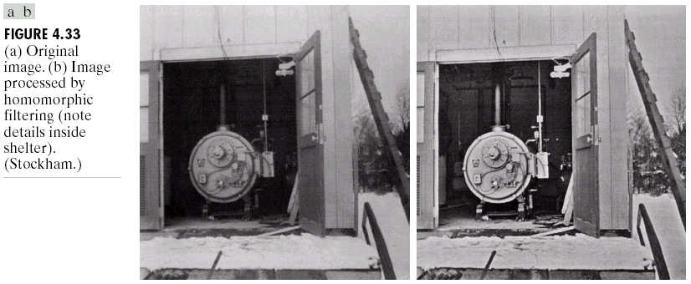
UNIT – II: Image Enhancement in the Frequency Domain
Example: Homomorphic Filtering

Slide 43
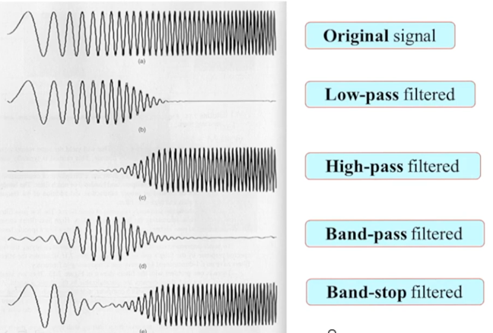
UNIT – II: Image Enhancement in the Frequency Domain
Selective Filtering

Slide 44
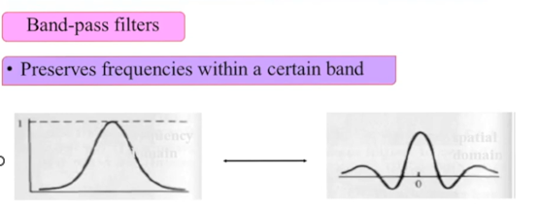
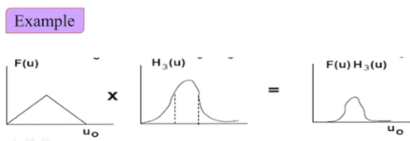
UNIT – II: Image Enhancement in the Frequency Domain
Selective Filtering

Slide 45
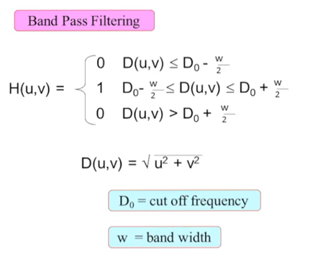
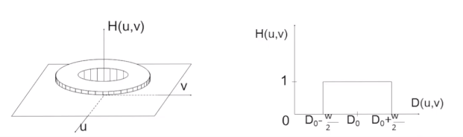
UNIT – II: Image Enhancement in the Frequency Domain
Selective Filtering

Slide 46
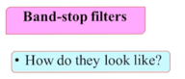
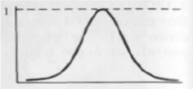
UNIT – II: Image Enhancement in the Frequency Domain
Selective Filtering

Slide 47

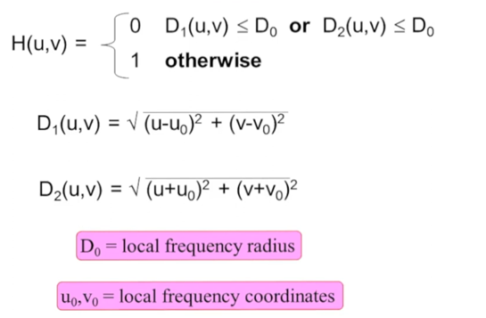
UNIT – II: Image Enhancement in the Frequency Domain
Selective Filtering

Slide 48
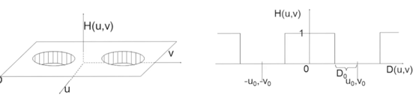
UNIT – II: Image Enhancement in the Frequency Domain
Selective Filtering

Slide 49
THE END

Slide 50
Thank you

